Slide 1
Linear Equations in Linear Algebra
1.2 Row Reduction and Echelon Forms
Bumhee Cho

Slide 2
A nonzero row or column
0
0
0
0
0
c00000
0 0 0 0 0 0 r 0 0 0 0 0 0 0 0 0 0 0
Notes:
최소한 하나

Slide 3
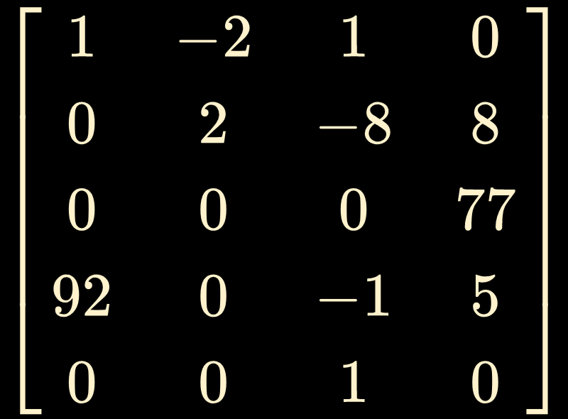
A leading entry of row
the leftmost nonzero entry
row 1
row 2
row 3
row 4
row 5

Slide 4
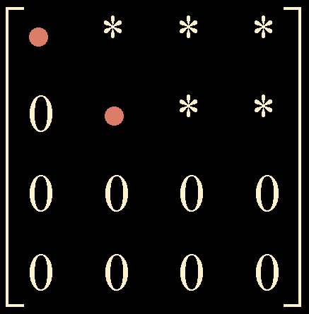
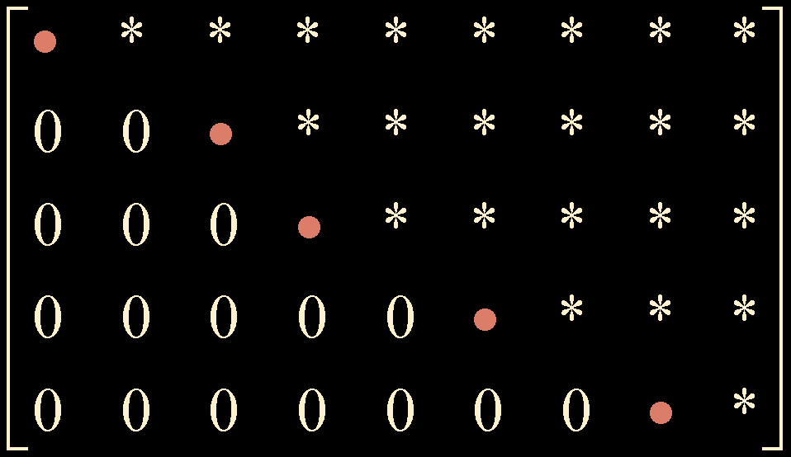
Echelon form
All nonzero rows are above any rows of all zeros.
Each leading entry of a row is in a column to the right of the leading entry of the row above it

Slide 5
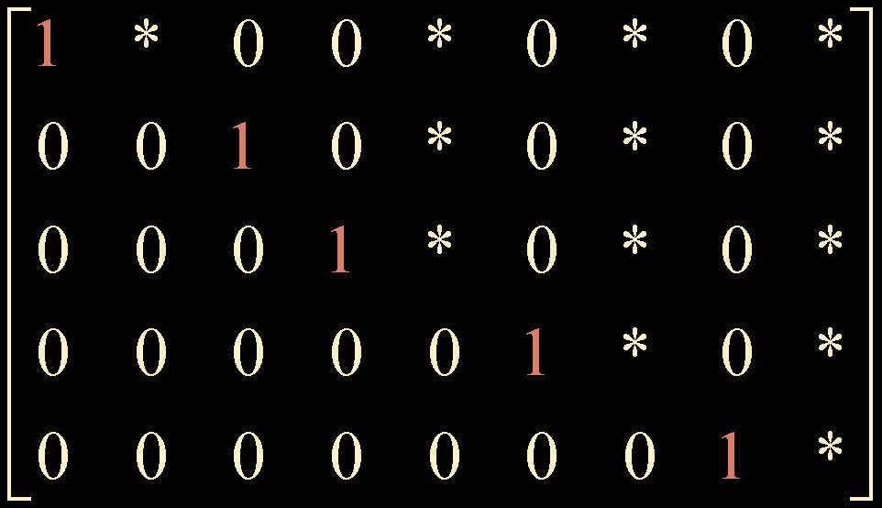
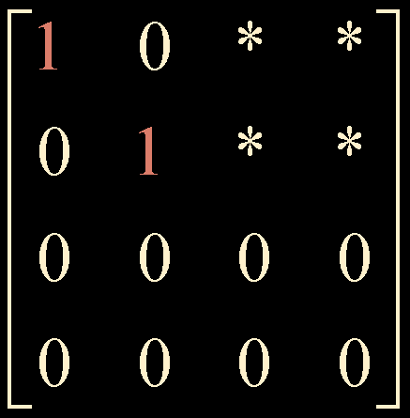
b
b
The leading entry in each nonzero row is 1.
Each leading 1 is the only nonzero entry in its column.
Reduced echelon form
pivot position
Theorem 1. Uniqueness of the Reduced Echelon Form
Each matrix is row equivalent to one and only one reduced echelon matrix.
Notes:
echelon form만가도 pivot position은 알수있음
4단원이상 증명가능

Slide 6
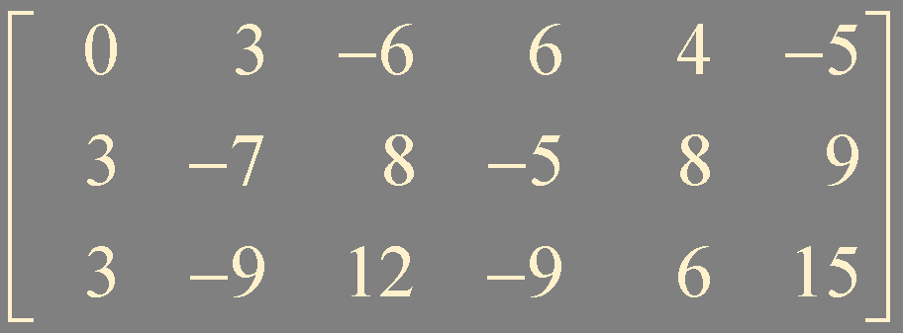
Row reduction algorithm
Step1. begin with the leftmost nonzero column
pivot position
pivot column

Slide 7
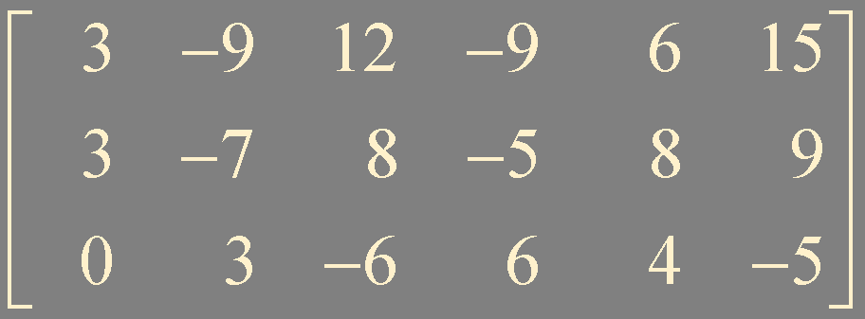
Step2. select a nonzero entry in the pivot column as a pivot. If necessary, interchange rows to move this entry into the pivot position
pivot

Slide 8

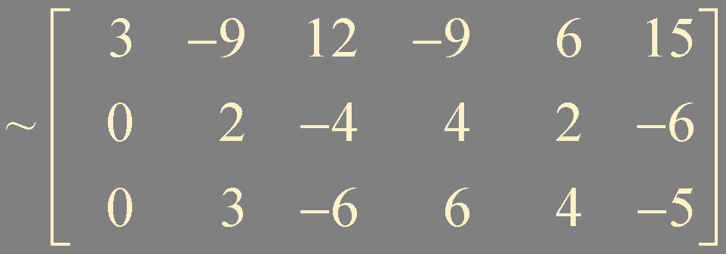
Step3. row replacement to create zeros in all positions below the pivot

Slide 9
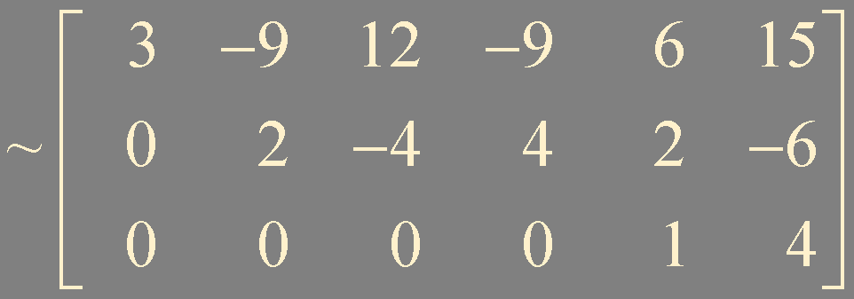
Step4. apply steps 1-3 to the submatrix that remain
pivot
new pivot column
pivot
The combination of steps 1-4 is called forward phase
echelon form !

Slide 10
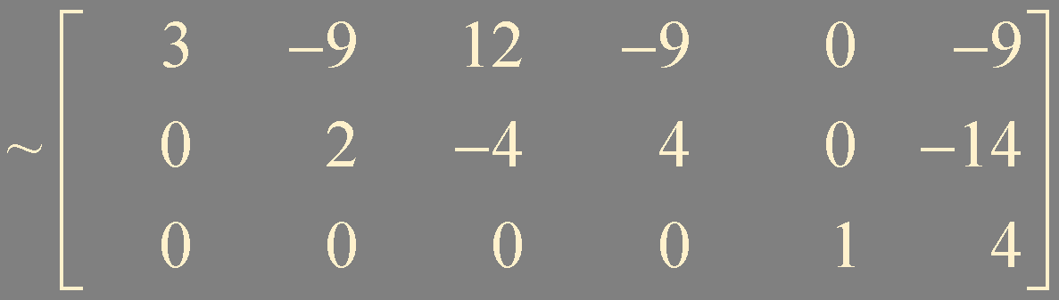
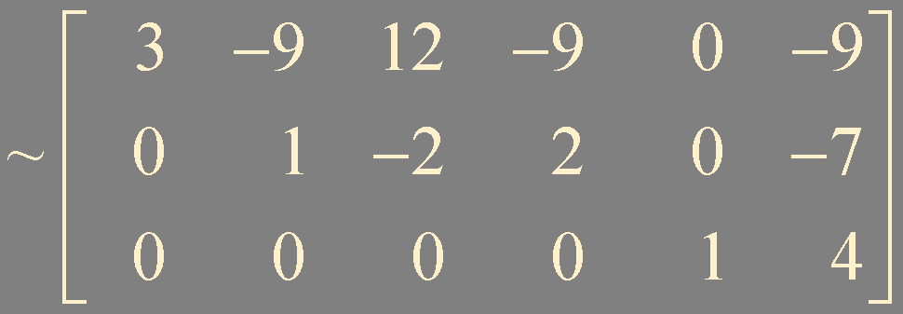
Step5. Beginning with the rightmost pivot and working upward and to the left, create zeros above each pivot. If a pivot is not 1, make it 1 by a scaling operation.
pivot

Slide 11
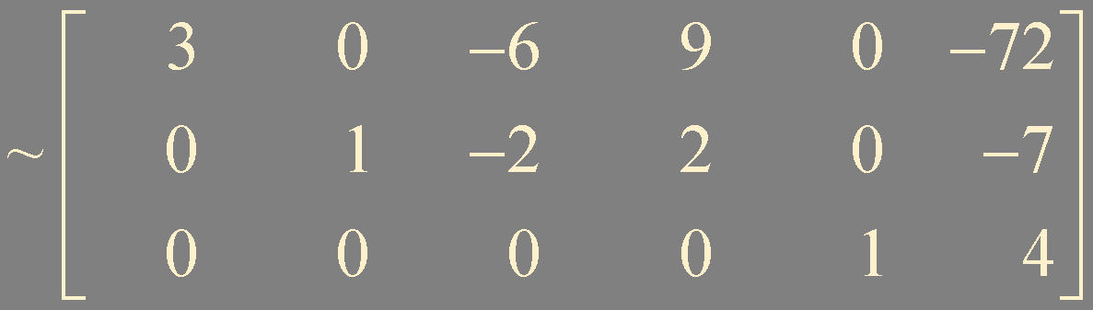
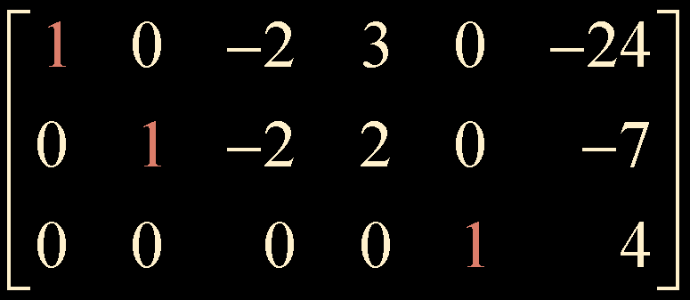
Steps 5 is called backward phase
reduced echelon form !

Slide 12
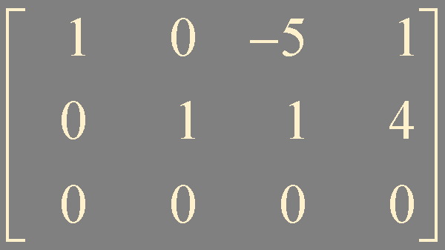
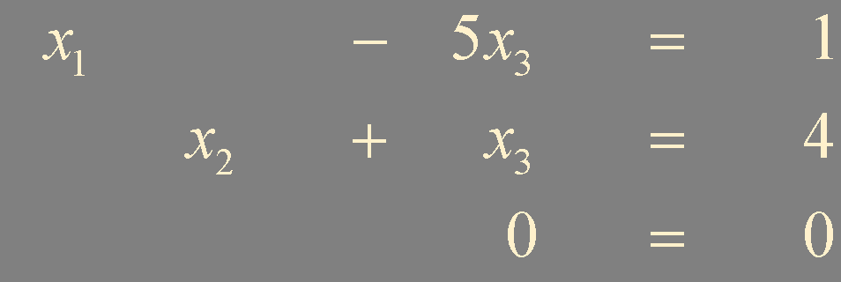

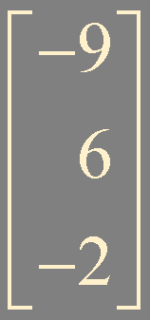

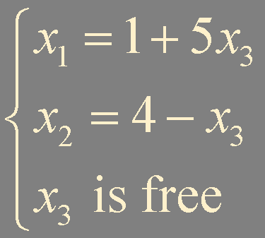
Solution of linear systems
basic variables
(leading variables)
general solution
Notes:
pivot 위치에 있는 애들이 basic 아닌애들을 free로 둠. free랑 basic이랑 바꿀수는 있지만 통상적으로 이리함

Slide 13
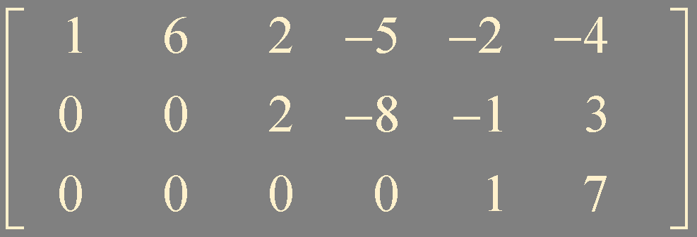
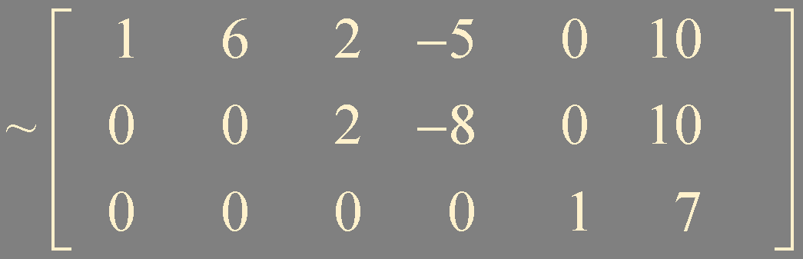
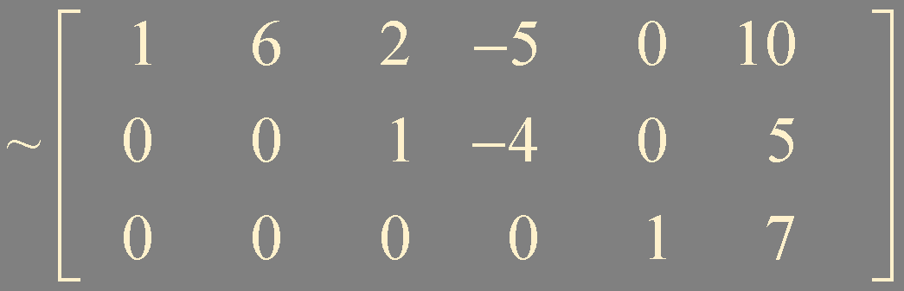
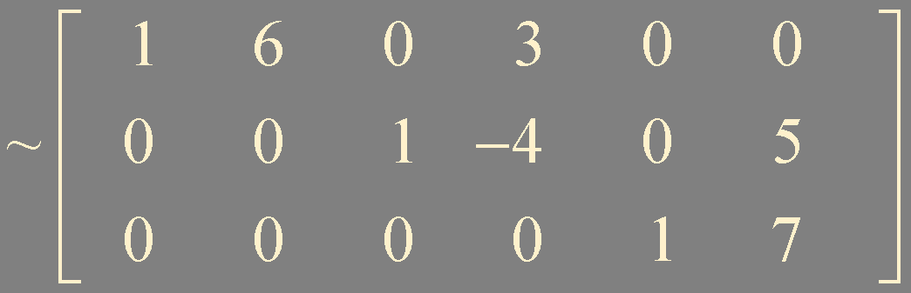
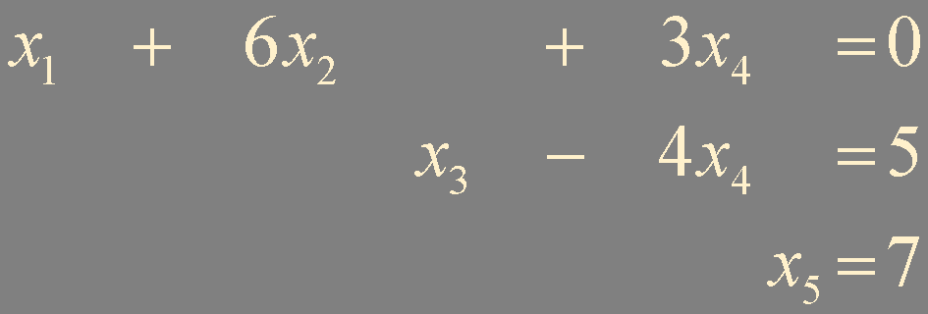
Example. find the general solution of the following augmented matrix

Slide 14
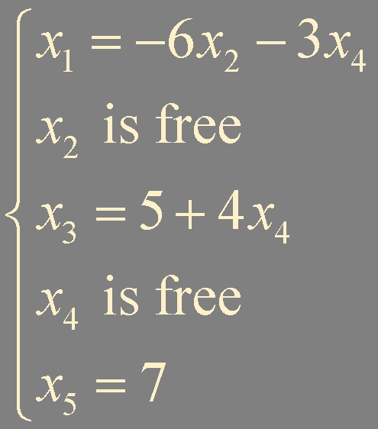

Slide 15
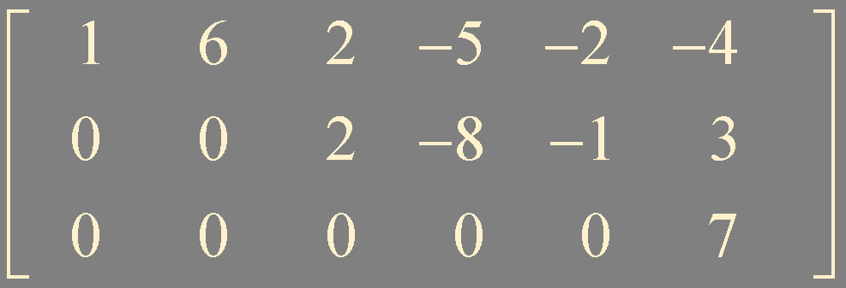

Theorem 2. Existence and Uniqueness Theorem
A linear system is consistent if and only if the rightmost column of the augmented matrix is not a pivot column - that is, if and only if an echelon form of the augmented matrix has no row of the forms
If a linear system is consistent, then the solution set contains either (i) a unique solution, when there are no free variables, or (ii) infinitely many solutions, when there is at least one free variables.

Slide 16
Summary
echelon form / reduced echelon form
theorem: uniqueness of the reduced echelon form
row reduction algorithm: forward and backward phases
solution of linear systems: general solution with free variables
theorem: Existence and Uniqueness Theorem

